Slide 1

Exam AZ-304: Microsoft Azure Architect Design Crash Course
Tim Warner

Slide 2


Tim Warner
Based in Nashville, TN, US
Central time zone
MCT, MVP
Twitter: @TechTrainerTim
Badge: TechTrainerTim.com

Slide 3
Day 1 of 2 Agenda
Introduction
Identity and Security Design
Storage Data Design

Slide 4
Day 2 of 2 Agenda
Content catch-up
Business Continuity Design
Infrastructure Design
Monitoring Design
Exam AZ-304 strategy

Slide 5
Course Materials
timw.info/az304

Slide 6
A Different Kind of Training
We'll learn by doing – at least 80 percent demo
Visual, case study approach
This is an expert certification, so we move quickly and assume intermediate-level Azure skills
10-minute break at midpoint
I’m here to answer your questions – take advantage of this!
Use the Q&A panel

Slide 7
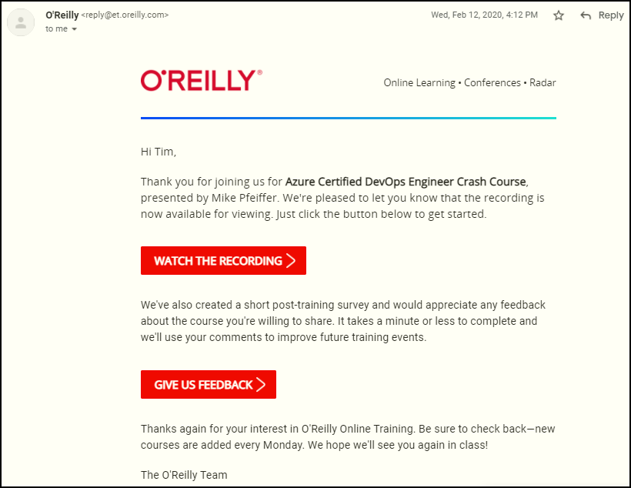
Session Recordings

Slide 8

Session Recordings

Slide 9

Session Recordings

Slide 10


Session Recordings

Slide 11
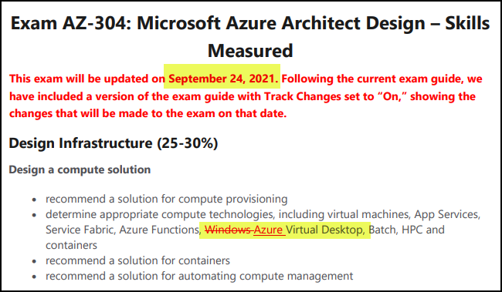
Exam AZ-304 Latest Changes

Slide 12
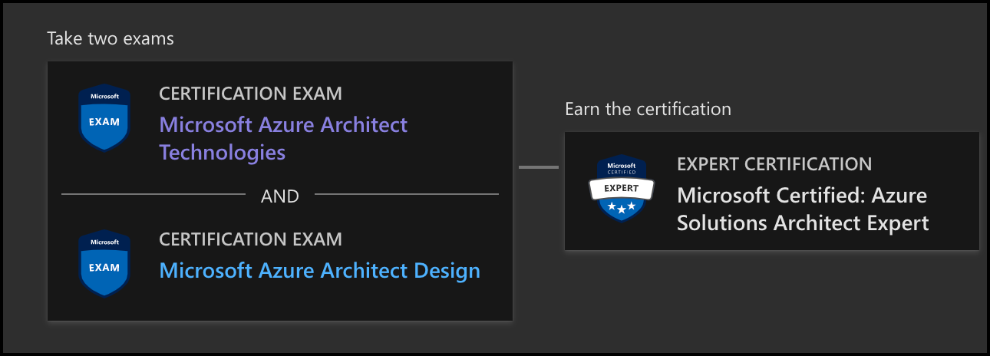
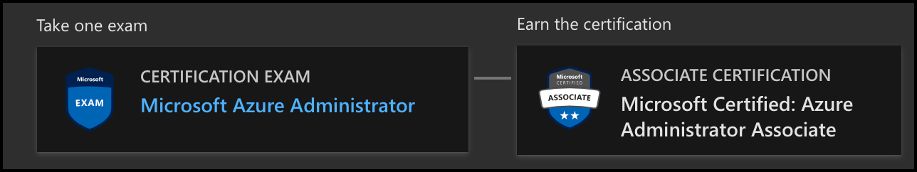
Azure Architect Certification
AZ-303
AZ-304
AZ-104

Slide 13

Tim's "Tower Bridge" Certification Study Model

Slide 14
Thank you!
Course materials: timw.info/az304
Twitter: @TechTrainerTim
Work: timw.info/ps
Web: TechTrainerTim.com

Slide 15
Authentication

Slide 16

Tenant vs. Subscription

Slide 17

Hybrid Identity

Slide 18

Azure AD B2C

Slide 19
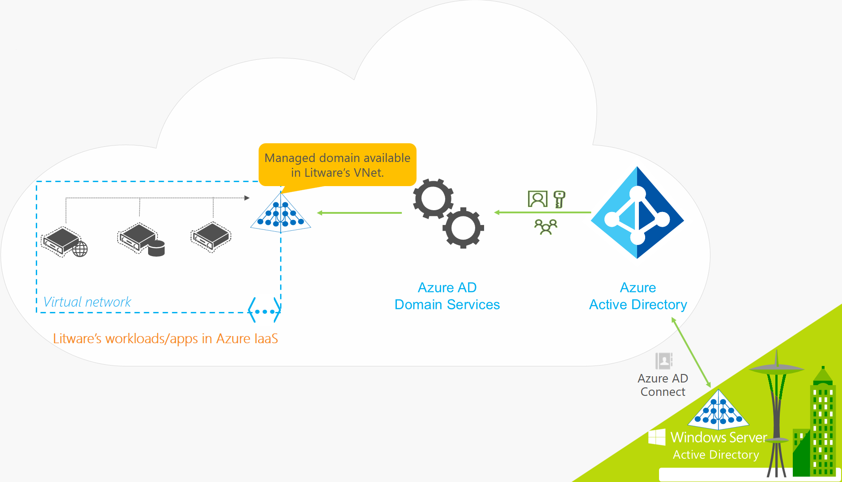
Azure AD Domain Services

Slide 20
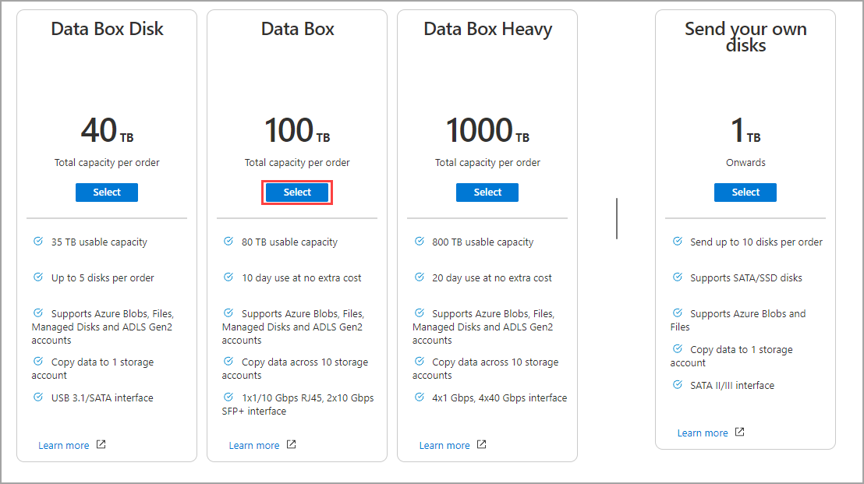
Azure Data Box

Slide 21

Pass-through Authentication

Slide 22

Seamless Single Sign-on

Slide 23
Authorization and Governance

Slide 24

Azure Management Scopes
/ Tenant Root

Slide 25
Azure Storage

Slide 26

Data Pipelines

Slide 27
Monitoring

Slide 28

Azure Diagnostics

Slide 29

Log Analytics

Slide 30

Sentinel

Slide 31
Storage Account Replication
1
3
3
2
LRS
ZRS

Slide 32
Storage Account Replication
3
3
GRS/RA-GRS

Slide 33
Storage Account Replication
1
3
1
3
2
2
GZRS – RA/GZRS

Slide 34

Always Encrypted

Slide 35
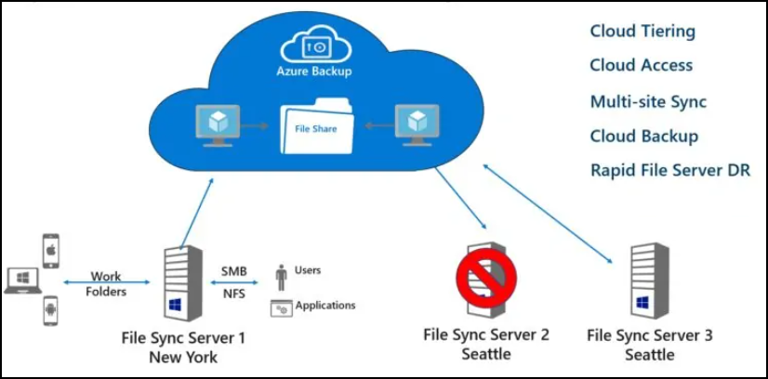
Azure File Sync

Slide 36
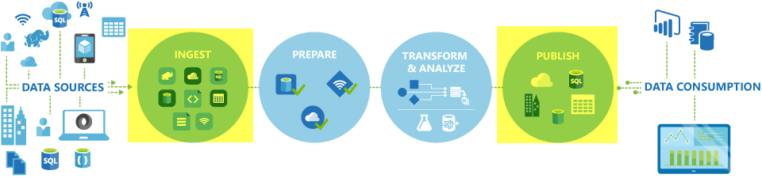
Azure Data Factory

Slide 37
Azure Monitor

Slide 38
Migration and Disaster Recovery

Slide 39

Azure Backup

Slide 40

Azure Site Recovery

Slide 41
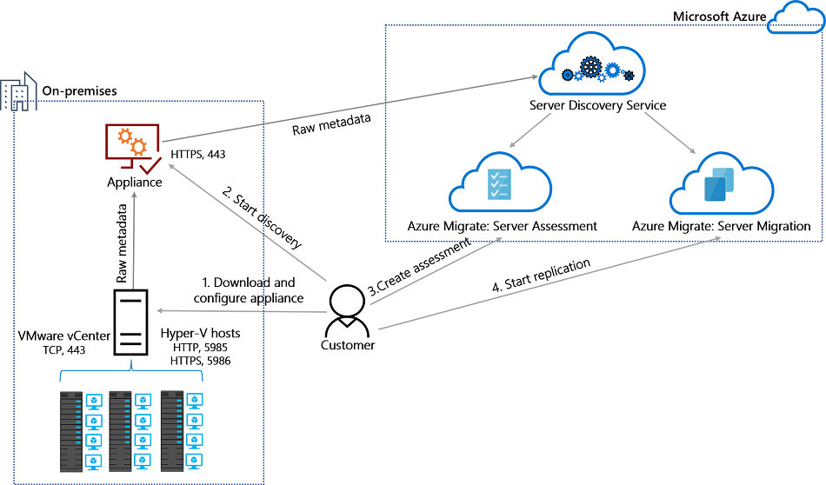
Azure Migrate

Slide 42
Azure Compute

Slide 43

VM Scale Sets

Slide 44
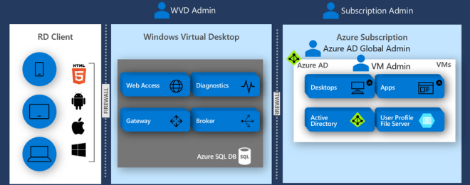
Windows Virtual Desktop (WVD)
timw.info/travis

Slide 45

Availability Set

Slide 46

Availability Zone

Slide 47
Load Balancing

Slide 48

VM Networking

Slide 49

Load Balancing

Slide 50

VNet Peering

Slide 51

Hybrid Networking

Slide 52

Network Virtual Appliance

Slide 53

Azure Load Balancer

Slide 54

Application Gateway

Slide 55

Traffic Manager

Slide 56

Front Door Service

Slide 57
Containers

Slide 58


Docker Container Lifecycle
https://timw.info/3635f

Slide 59
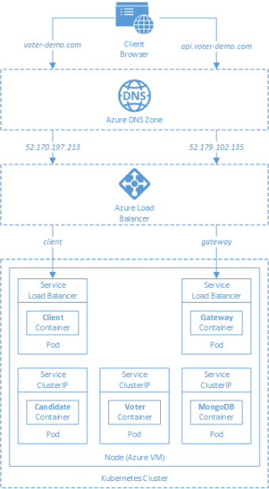
AKS

Slide 60
App Architecture

Slide 61

Event Architecture

Slide 62

Event Architecture

Slide 63
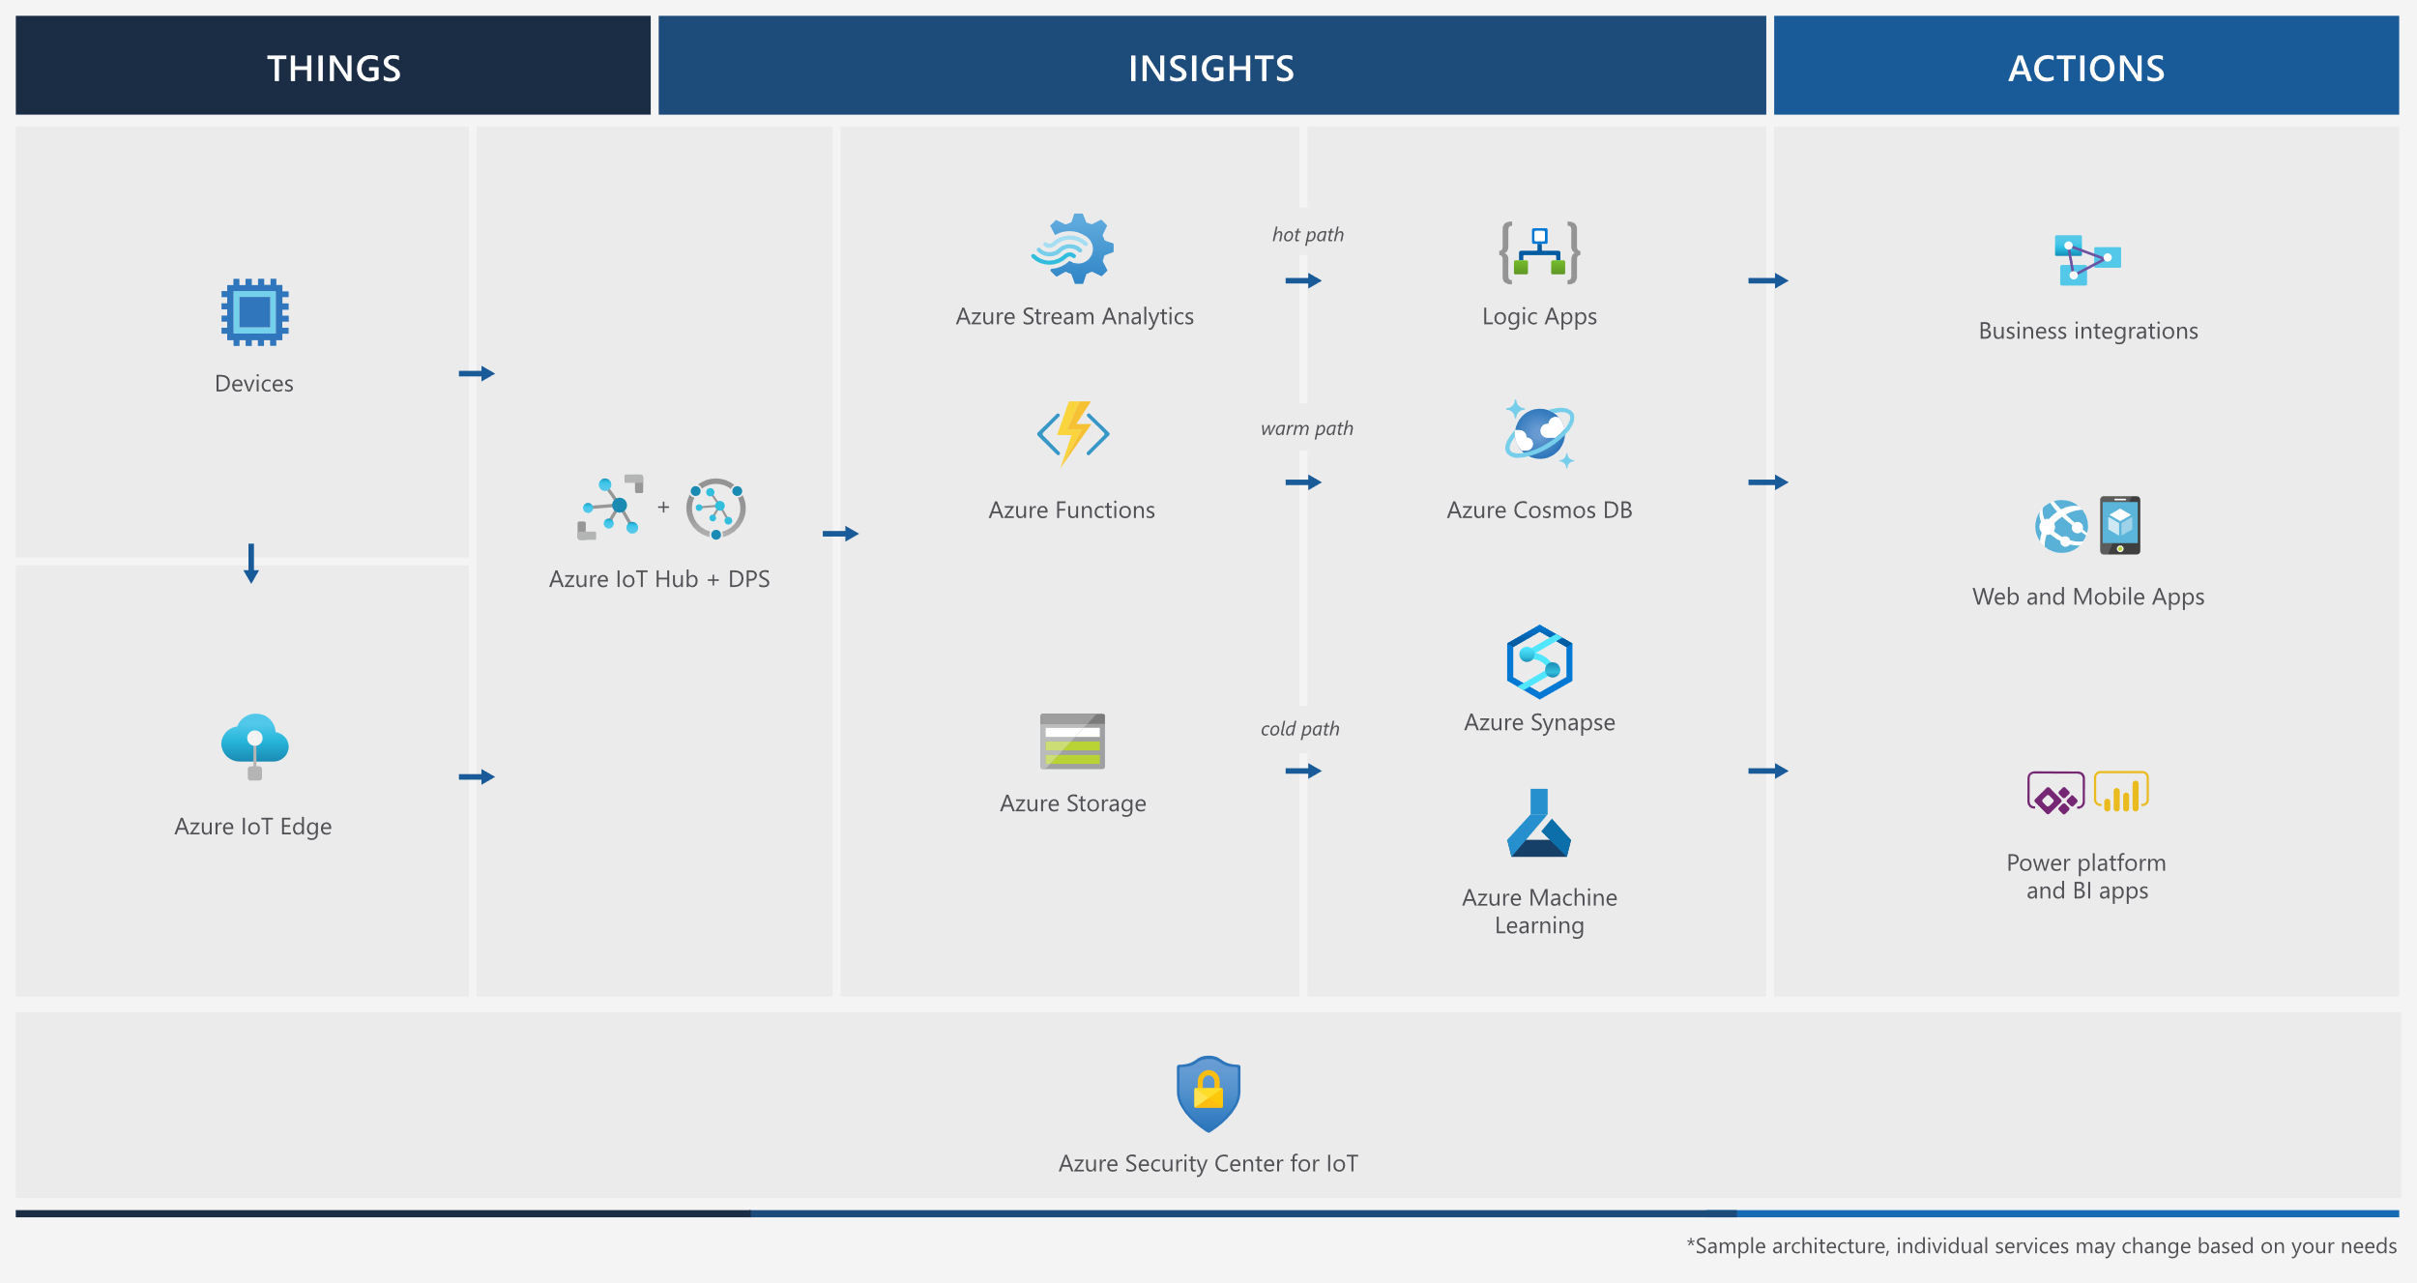
Event Architecture

Slide 64
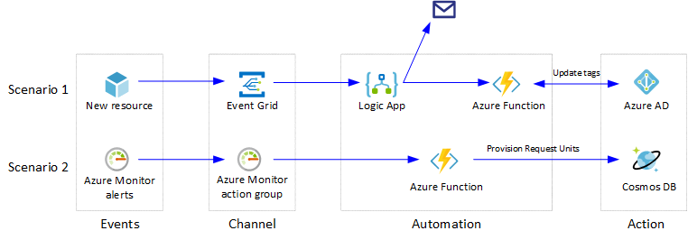
Event Architecture

Slide 65
Exam AZ-304 Item Types

Slide 66

Multiple Choice

Slide 67
Repeated Scenario
You need to move an Azure VM to another hardware host.
Solution: You redeploy the VM.
Does this solution meet the goal?
Yes
No

Slide 68

Select and Place

Slide 69

Build List and Reorder

Slide 70

Active Screen/Fill in the Blank

Slide 71

Case Study

Slide 72






Performance-Based Lab

Slide 73
Microsoft Online Testing

Slide 74
Microsoft Online Testing Process
timw.info/online

Slide 75

Microsoft Online Testing Process

Slide 76

Microsoft Online Testing Process

Slide 77

Microsoft Online Testing Process

Slide 78

Microsoft Online Testing Process

Slide 79

Microsoft Online Testing Process

Slide 80

Microsoft Online Testing Process

Slide 81

Microsoft Online Testing Process

Slide 82
AZ-304 Exam Strategy
Focus your skills accordingly:
60 percent Azure portal
20 percent Azure PowerShell
10 percent Azure CLI
10 percent KQL
Expect performance-based labs, but be thankful if you don't see 'em

